Slide 1
Chapter 9: Virtual Memory

Slide 2
Background
Virtual memory – separation of user logical memory from physical memory.
  Only part of the program needs to be in memory for execution.
  Logical address space can therefore be much larger than physical address space.
  Allows address spaces to be shared by several processes.
  Allows for more efficient process creation.
Virtual memory can be implemented via:
  Demand paging
  Demand segmentation

Slide 3
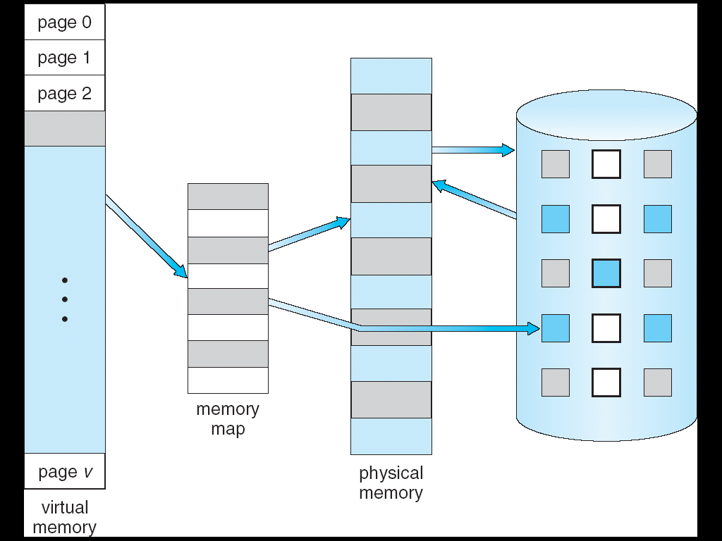
Virtual Memory That is Larger Than Physical Memory
⇒

Slide 4

Virtual-address Space

Slide 5

Shared Library Using Virtual Memory

Slide 6
Demand Paging
Bring a page into memory only when it is needed
  Less I/O needed
  Less memory needed
  Faster response
  More users
Page is needed ⇒ reference to it
  invalid reference ⇒ abort
  not-in-memory ⇒ bring to memory

Slide 7
Valid-Invalid Bit
With each page table entry a valid–invalid bit is associated
(1 ⇒ in-memory, 0 ⇒ not-in-memory)
Initially valid–invalid but is set to 0 on all entries
Example of a page table snapshot:
Frame #
valid-invalid bit
1
1
1
1
0

0
0
page table

Slide 8

Page Table When Some Pages Are Not in Main Memory

Slide 9
Page Fault
If there is ever a reference to a page, first reference will trap to OS ⇒ page fault
OS looks at another table to decide:
  Invalid reference ⇒ abort.
  Just not in memory.
Find empty frame.
Load page from disk into frame.
Reset tables, validation bit = 1.
Restart instruction that caused page fault

Slide 10

Steps in Handling a Page Fault

Slide 11
What happens if there is no free frame?
Page replacement – find some page in memory, but not really in use, swap it out
  algorithm
  performance – want an algorithm which will result in minimum number of page faults
Same page may be brought into memory several times

Slide 12

Need For Page Replacement

Slide 13
Basic Page Replacement
Find the location of the desired page on disk
Find a free frame:
- If there is a free frame, use it
- If there is no free frame, use a page replacement algorithm to select a victim frame
Read the desired page into the (newly) free frame. Update the page and frame tables.
Restart the process

Slide 14

Page Replacement

Slide 15
Page Replacement
Use modify (dirty) bit to reduce overhead of page transfers – only modified pages are written to disk
Page replacement completes separation between logical memory and physical memory – large virtual memory can be provided on a smaller physical memory
Solve two problems in demand paging implementation:
  Frame-allocation algorithm – how many frames to allocate to each process
  Page-replacement algorithm – select frames to be replaced

Slide 16

Graph of Page Faults Versus The Number of Frames

Slide 17
Page Replacement Algorithms
Want lowest page-fault rate
Evaluate algorithm by running it on a particular string of memory references (reference string) and computing the number of page faults on that string
In all our examples, the reference string is
1, 2, 3, 4, 1, 2, 5, 1, 2, 3, 4, 5

Slide 18
First-In-First-Out (FIFO) Algorithm
Reference string: 1, 2, 3, 4, 1, 2, 5, 1, 2, 3, 4, 5
3 frames (3 pages can be in memory at a time per process)
4 frames
FIFO Replacement – Belady’s Anomaly
  more frames ⇒ more page faults
1
1
4
5
2
2
1
3
9 page faults
3
3
2
4
1
1
5
4
2
2
1
5
10 page faults
3
3
2
4
4
3

Slide 19

FIFO Page Replacement

Slide 20

FIFO Illustrating Belady’s Anomaly

Slide 21
Optimal Algorithm
Replace page that will not be used for longest period of time
4 frames example
1, 2, 3, 4, 1, 2, 5, 1, 2, 3, 4, 5
How do you know this?
Used for measuring how well your algorithm performs
1
4
2
6 page faults
3
4
5

Slide 22

Optimal Page Replacement

Slide 23
Least Recently Used (LRU) Algorithm
LRU replaces page that has not been used for the longest time
Use the recent past to predict the future
Reference string: 1, 2, 3, 4, 1, 2, 5, 1, 2, 3, 4, 5
1
5
2
8 page faults
3
5
4
4
3

Slide 24

LRU Page Replacement

Slide 25
LRU Algorithm (Cont.)
Counter implementation
  Every page entry has a counter; every time page is referenced through this entry, copy the clock into the counter
  When a page needs to be replaced, look at the counters to determine which has the oldest time-of-access
Stack implementation – keep a stack of page numbers in a double link form:
  Page referenced -> move it to the top of stack
    bottom of stack will be the LRU page
  No search for replacement

Slide 26

Use Of A Stack to Record The Most Recent Page References

Slide 27
Thrashing
If a process does not have “enough” frames, the page-fault rate is very high. This leads to:
  low CPU utilization
  operating system thinks that it needs to increase the degree of multiprogramming
  another process added to the system
Thrashing ≡ a process is busy swapping pages in and out

Slide 28

Thrashing (Cont.)

Slide 29
Demand Paging and Thrashing
Why does demand paging work?
Locality model
  Locality = set of pages in active use
  Process migrates from one locality to another, e.g. main function, subroutine
  Localities may overlap
Why does thrashing occur?
  size of locality > size of allocated frames

Slide 30

Page-Fault Frequency Scheme
Establish “acceptable” page-fault rate
  If actual rate too low, process loses frame
  If actual rate too high, process gains frame

Slide 31
Other Issues -- Prepaging
Prepaging
  To reduce the large number of page faults that occurs at process startup
  Prepage all or some of the pages a process will need, before they are referenced
  But if prepaged pages are unused, I/O and memory was wasted
  Assume s pages are prepaged and a fraction α of the s pages is used (0 <= α <= 1)
    Is cost of s * α saved pages faults > or < than the cost of prepaging s * (1- α) unnecessary pages?
    α near zero ⇒ prepaging loses
    α near one ⇒ prepaging wins

Slide 32
Other Issues – Page Size
Page size selection must take into consideration:
  fragmentation
  table size
  I/O overhead
  locality

Slide 33
End of Chapter 9

